Slide 1

Public Sentiments under pandemic
Public Sentiments under Covid-19
Team: Light Yellow Dress & Fluffy Hair

Slide 2

Table of Contents
Motivation
Approach
Data Description
Model Building
Analysis
Recommendation

Slide 3





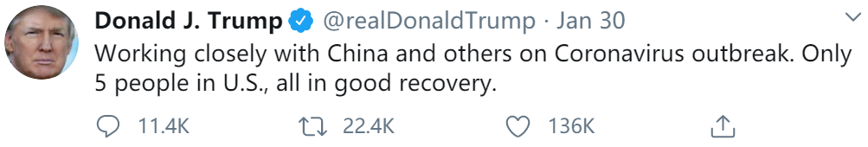
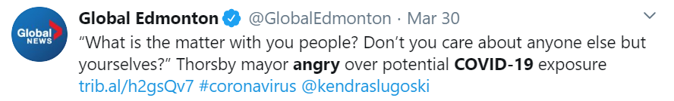
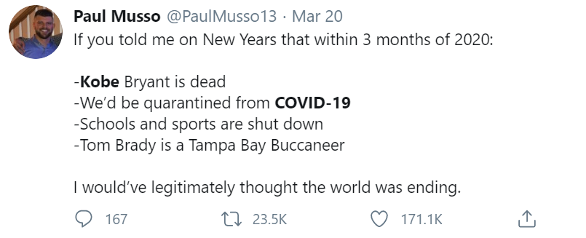
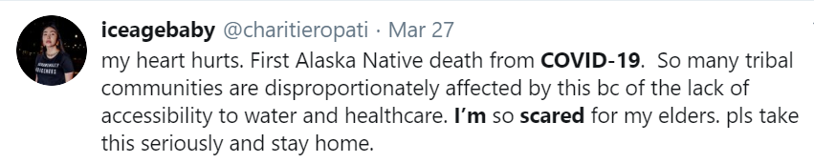
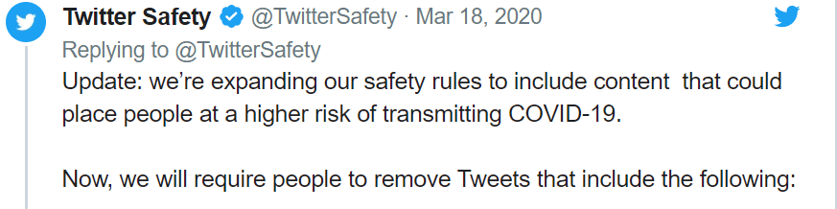
Motivation - Why Study Public Sentiments
Public Sentiments
Public’s attitudes towards coronavirus vary drastically.
Understanding the public sentiments help us react faster and in a proper way.
Notes:
What inspired us: The drastic emotional responses on Twitter -- public’s attitudes towards coronavirus vary and change over time: optimistic v.s. skeptical, emotional v.s. rational.
During the panic of coronavirus, it is crucial to know the how the public react to the events and how their sentiments affect their behaviors. Understanding the public sentiments help us react faster and in a proper way. (e.g. Twitter Safety Rule)

Slide 4
Problem:
How are public sentiments changing under Covid-19?
Do people become more panic as coronavirus spreads?
Do people become more pessimistic?
How can we help when sense a status change?
Notes:
The major problem we want to solve is that How are public sentiments changing under Covid-19?
We try to offer an analytical view to the public that how public sentiments changes with the development of Covid 19 and their effects.
Social media and news best represent public sentiments . So we focus our scope on Twitter, Fox News and CNN, which are representative of social media and news. To narrow down the condition, we choose U.S. to analyse.

Slide 5

How to measure public sentiments?
Extract the Sentiments
Natural Language Processing
for sentiment analysis
and topic modeling
1
2
3
Source for Sentiments
Web scraping text data
from multi-platforms
E.g. Twitter, CNN & Fox News)
Insight Visualization
Tableau Dashboards
to show the insights
Notes:
Our approach to tackle the problem can be divided into 3 steps:
We mainly utilized web scraping and APIs to collect the data we need. For Twitter, we used TwitterScraper API to retrieve 80-day Twitters and web scraped corresponding trending topics. For news, we web scraped CNN news and Fox News.
We applied NLP algorithms to analyze sentiment of Twitter and extract topics in news.
We used Tableau to visualize the key insights behind the models.

Slide 6
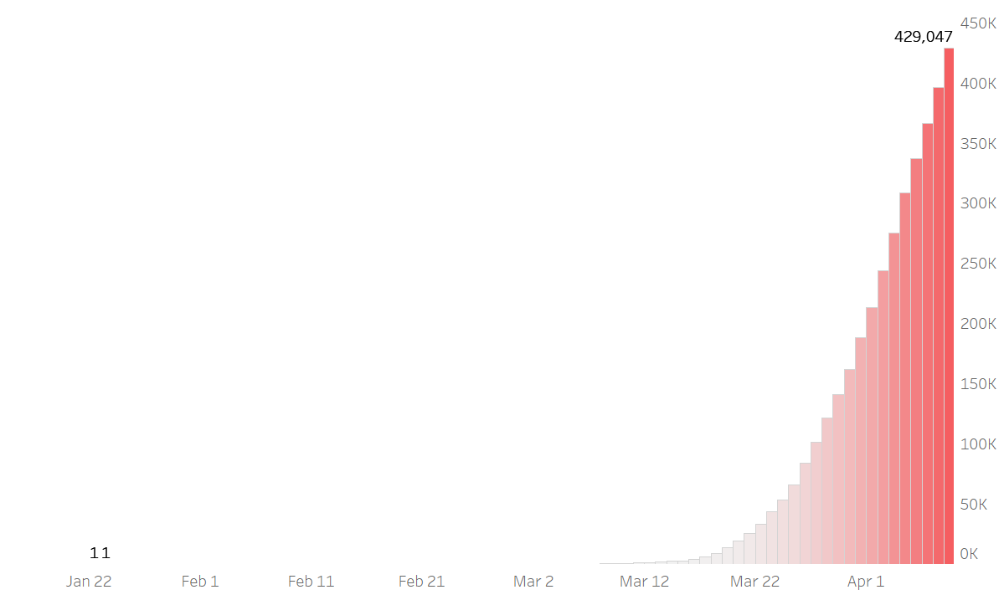


Data Description
1,100,069
+ 4100 #Trending Topics
1.20 - 4.8 daily
1.20 - 4.8 daily, #covid-19 & #coronavirus,
From Trendogate.com, Twitter Scraper API
8,300+
Confirmed Cases:
Data Source:
Johns Hopkins CSSE
Date Range:
1.20 – 4.8
1.22 - 4.8 daily, Search Term: covid-19 | coronavirus,
From CNN News and FOX News
Notes:
Combining cross-platform data to create business insights
Choose two of the most trustworthy news platform as reference

Slide 7






Sentiments - Beyond positive & negative
To generate multi-dimensional public sentiments,
we tagged the sentiment along with the Tone Analyzer and fed the BERT Classification Model
Confident
Random
Sampling
IBM Watson Tone Analyzer API
Training Data with Tones (adjusted)
Fear
Analytical
Rest of Data
(partially labeled)
Google BERT Classification
Anger
Sadness
To aid the understanding of sentiment trends, we used Topic Modeling to gather simultaneous news topics……
Notes:
In twitter sentiment analysis, what we did specially is to step beyond the binary classification and look into multi-dimension sentiments – as we call it, public sentiments.
And how did we extract multi-dimensional sentiments from tweets?
1, To increase the dimensions of our sentiment analysis, we used IBM’s Watson Tone Analyzer as a reference and obtained 5 different types of sentiments(Confident, Fear, Analytical, Anger, Sadness) for modeling. We improved the algorithm by amending the tags IBM provided and introduced the BERT method to train our predictive model. The results were checked and adjusted accordingly. Compared to other alternatives, BERT requires much less time and less data to train, and yields better accuracy. It is a good fit for our case where we have limited training data.

Slide 8

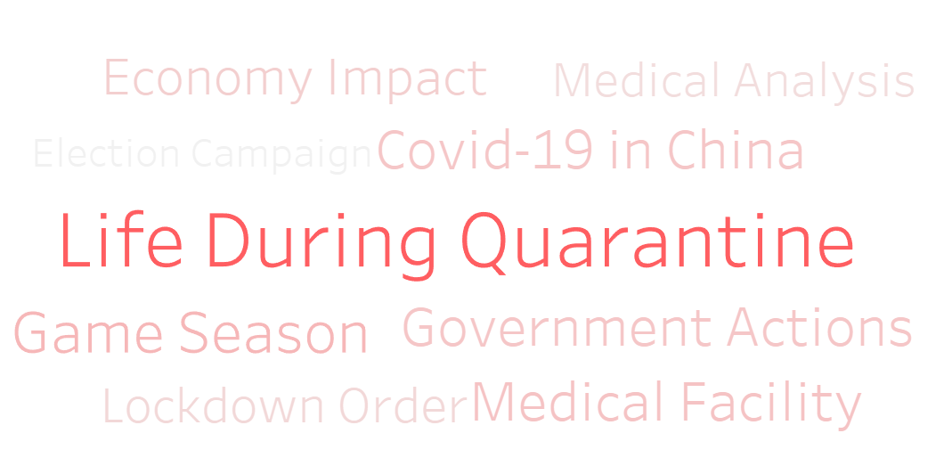
News Topics – Better Understand Sentiments
To aid the understanding of sentiments,
we used Topic Modeling on News texts to gather simultaneous news topics
Confident
Topic Modeling
Help Understanding
Fear
Analytical
Anger
Sadness
Notes:
To help understand the focuses of the news, we also use LDA to extract 9 topics from the news articles we scraped. So that, when observing certain trends or spikes in the sentiments, we can monitor the news topics simultaneously, which helps better understand the reasons behind the public sentiments.

Slide 9
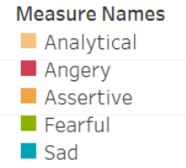
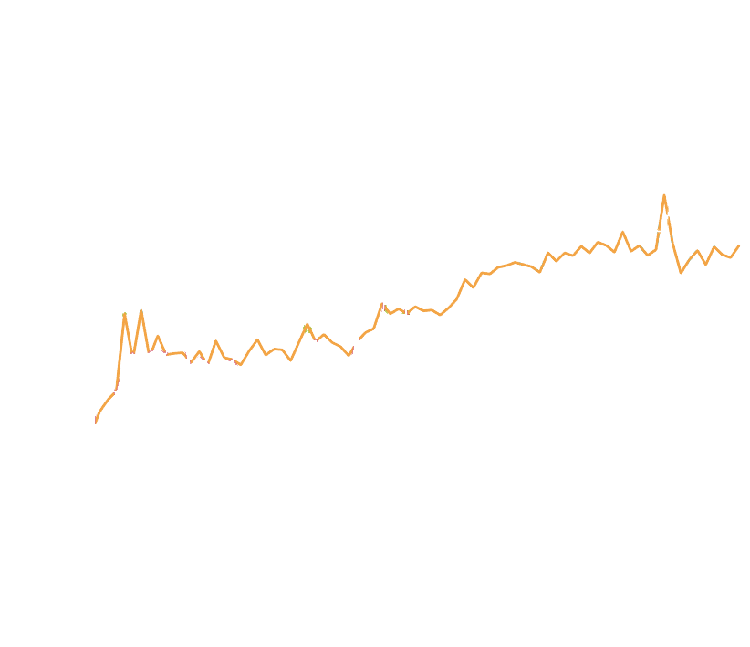
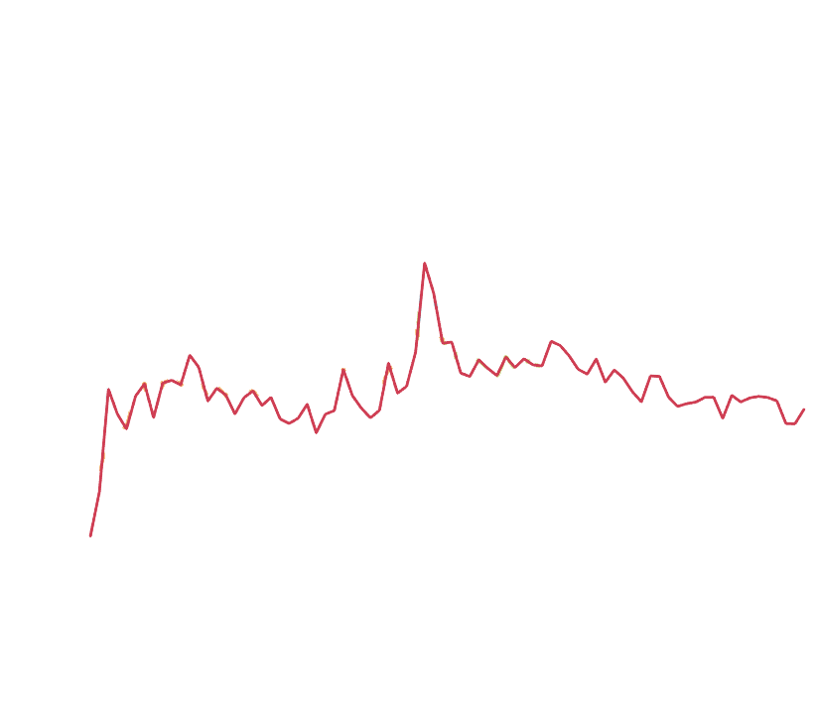
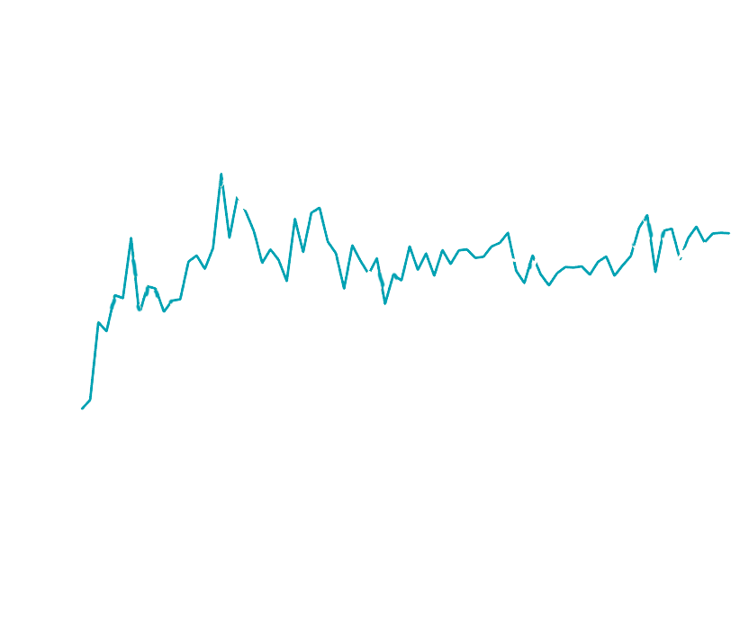
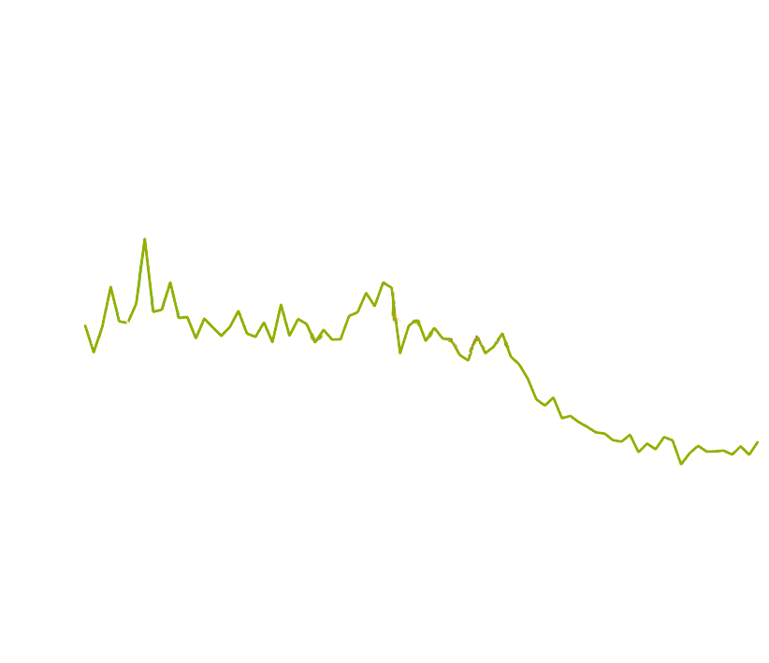
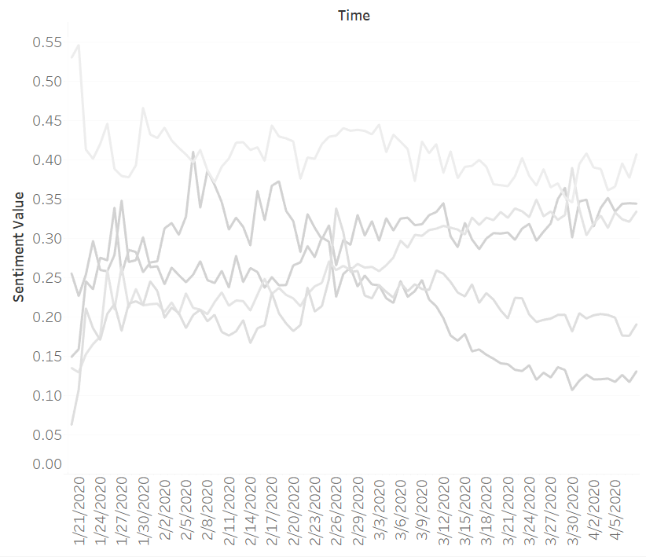
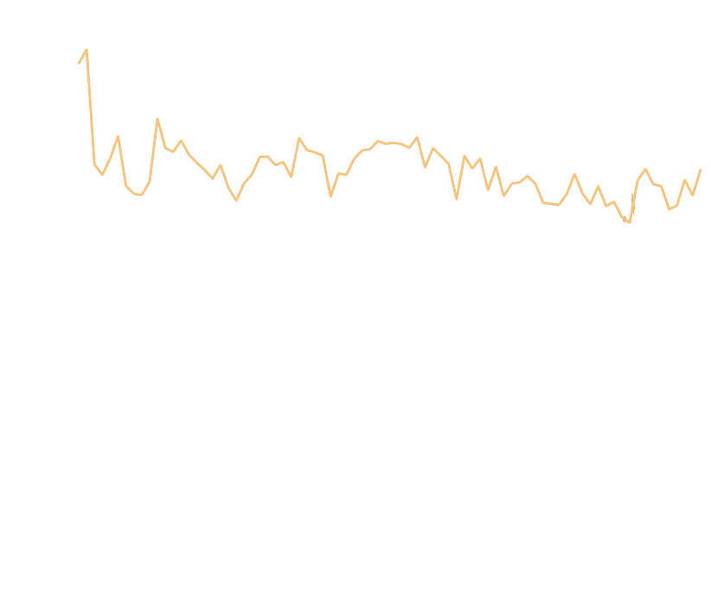


Trend Overview - Sentiments diverge
5 sentiment trend lines reflect the trends of social mental status
on coronavirus：
As time passed, different sentiments tended to diverge, fear goes down. Overloaded with information makes people less sensitive.
Right after 1st case (Jan 21st), Mixed sentiments went up due to increasing social awareness.
Before 1st case in the U.S., Analytical sentiment was detected most in tweets, other remained low.
Fear and Anger have similar moving trends. Sadness volatile but remains relatively high.
Notes:
General trends: These 5 lines properly reflect the trends of people’s social mental status on coronavirus.
Before the 1st case was confirmed in the U.S., analytical sentiment was detected most in tweets, other sentiments remained low.
Right after 1st case (Jan 21st), mixed sentiments arised due to increasing social awareness.
Fear and Anger have similar moving trends. Sadness volatile but remains relatively high.
As time passed, different sentiments tended to diverge, assertive increased, fear goes down. Overloaded with information makes people less sensitive.

Slide 10
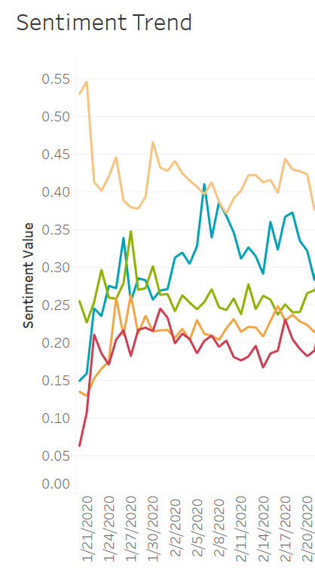
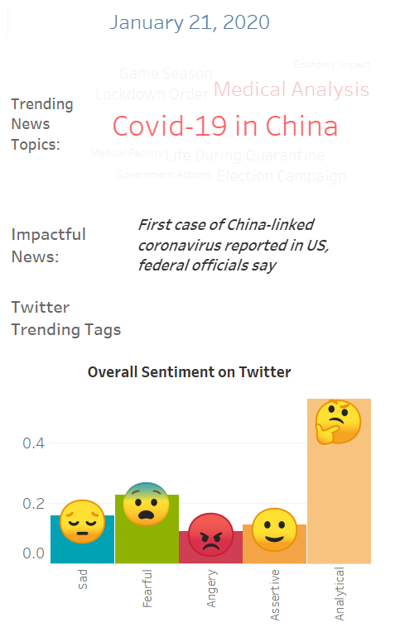
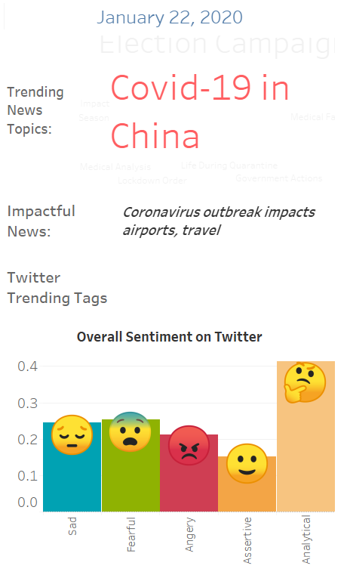
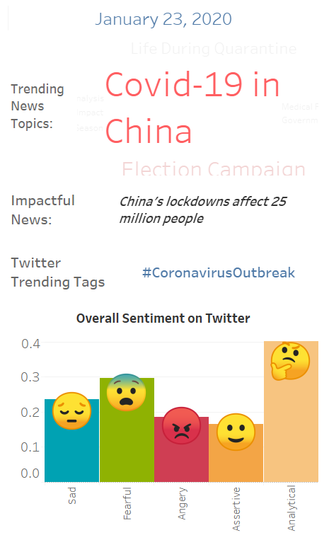
Everyday Sentiment – behind the spike
Notes:
Besides the general trends, we can observe closely the day-on-day changes using the Tableau dashboard above.
Change in Each Sentiment: We can measure the change in each sentiments, and gain related news information that could cause the status changes
World Cloud News Topic: We created a word cloud for each day containing the top 9 topics summarized by the Topic Modelling run on text news from 1.20 to 4.8.
Twitter Trending Tags: Twitter tags of the day serve as another reflection of people’s attitudes towards the pandemic.
With all the information provided, we can extract the overall public sentiments. When observe a continuous increase or decrease of certain sentiments, we can investigate into it timely with the trending news and tags at the same time, and take action.

Slide 11



Actionable Recommendations – use cases
Twitter | Medical Institutions | Business Owners
Monitor sentiment trend Study abnormal spikes Augment the safety rules and stop rumors in time. | Overwatch public sentiments Provide help alleviating extreme emotions | Care about customers’ emotion change Marketing campaign accordingly and appropriately (e.g. Corona beer)
Notes:
Our analysis and visualization can be used by Twitter, medical institutions, and business owners.
Twitter: As a social media, Twitter takes the responsibility to control negative rumors spreading during this period for the social good. Twitter can monitor the sentiment trends and study the abnormal emotion peaks like what we did.
Medical Institutions: Our analysis can help medical institutions know the emotion changes during the COVID-19. Doctors can provide help to people who potential have mental health problem.
Business Owners: Keeping a watchful eye on trending topics and people’s emotion change can help business owners run marketing campaign appropriately and find out potential business opportunities, such as new services that needed by people.

Slide 12
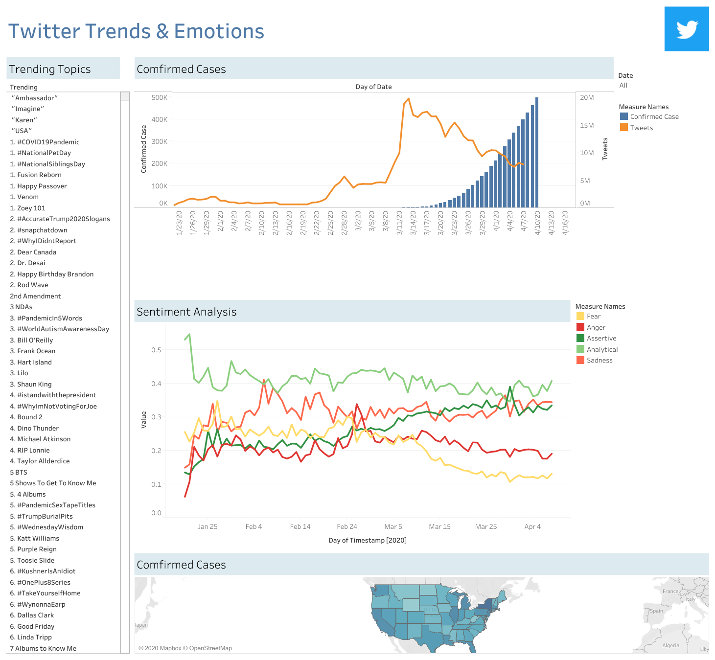
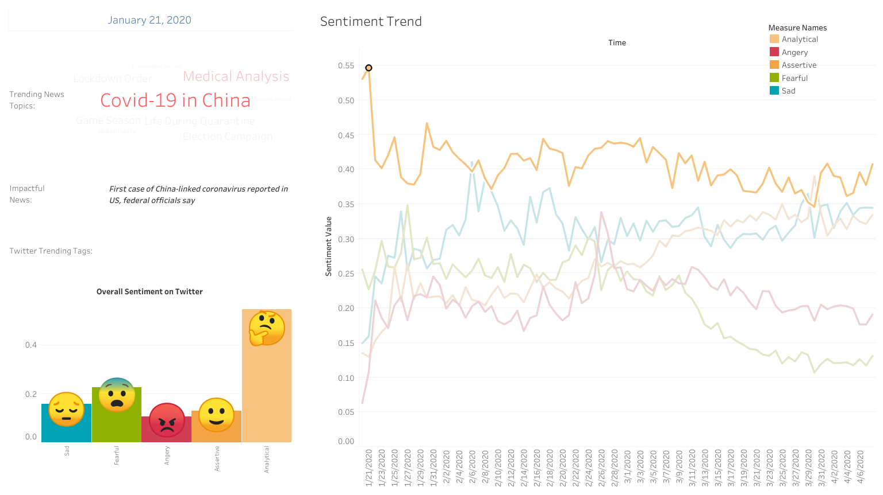
Thank you!
If you are interested, please check out for our full dashboards!
Links are on Github.

Slide 13
Appendix – Full Data Description
Confirmed Cases | News | Twitter Tweets & Trends
Data Source Johns Hopkins CSSE | Data Source web-scraped coronavirus-related news covered by 2 news websites, CNN and Fox News. | Data Source Tweets under the key words ‘COVID’ and ‘coronavirus’ scraped using twitter api on a daily basis (from Jan. 20th to April 8th), limited by language = English. Retrieved by TwitterScraper API. Twitter trending topics from Jan. 20th to April 11th. archived from https://trendogate.com/ & https://us.trend-calendar.com/
Data Characteristic Confirmed cases time series data in the U.S. | Data Characteristic Time published, title, body part of the news, sources | Data Characteristic Timestamp, Tweet text, trending topics

Slide 14
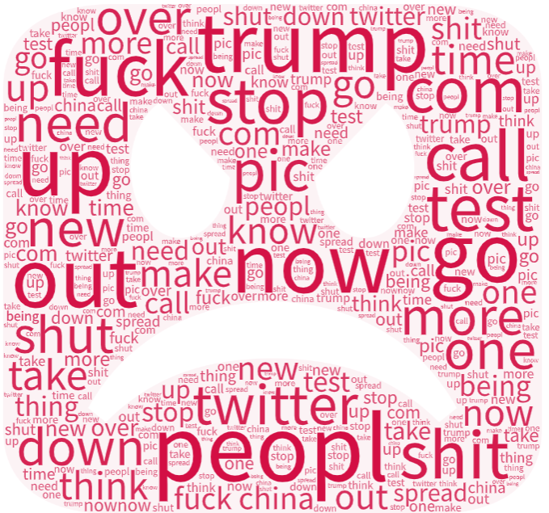
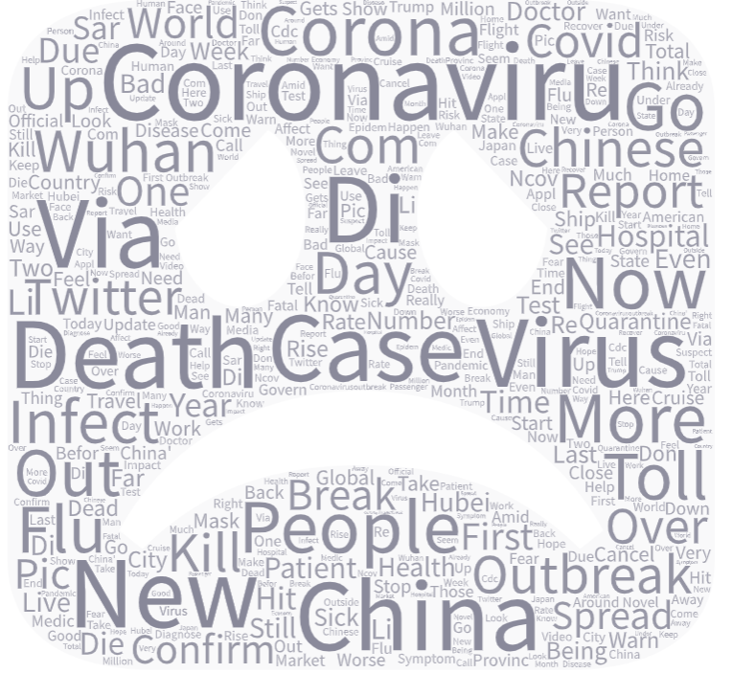
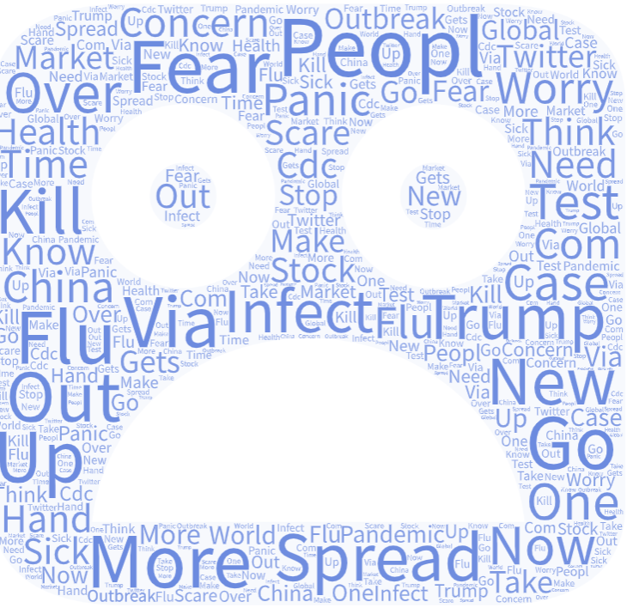
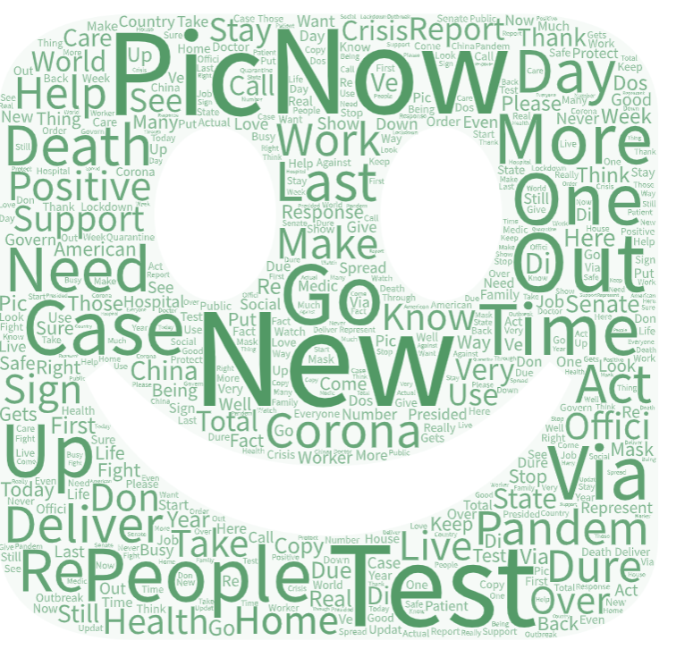
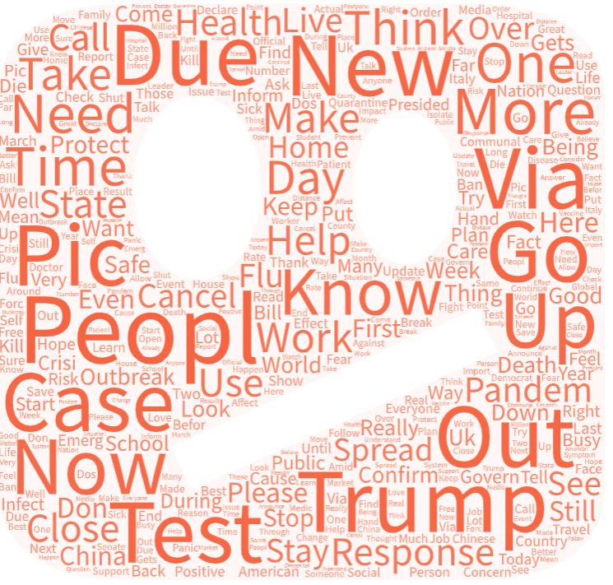
Appendix - Five Emotions in Tweets
Angry
Sadness
Fear
Confident
Analytical

